Slide 1
Step 8 Azure Monitor

Slide 2
Goal
Learn how to use Azure Monitor to have a better visibility into anything that can impact your app availability and performance

Slide 3
What is Azure Monitor?
Azure Monitor is part of Microsoft Azure's overall monitoring solution. Azure Monitor helps you track performance, maintain security, and identify trends.

Slide 4
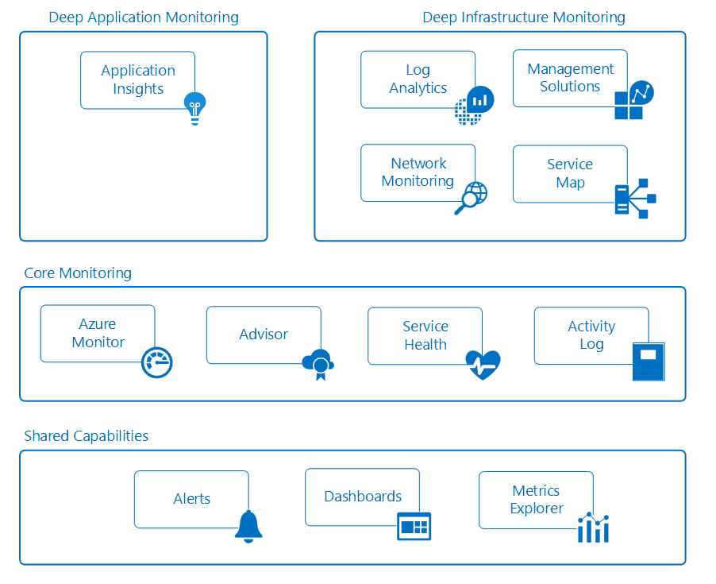

Slide 5
Confusing?
APPINSIGHTS VS AZURE MONITOR VS OMS
Notes:
Application Insights : offers rich detection and diagnostics for issues at the application layer of your service. This is about YOUR code and how well it runs.
Azure Monitor : Offers visualization, query, routing, alerting, autoscale, and automation on data both from the Azure infrastructure (Activity Log) and each individual Azure resource (Diagnostic Logs). It was previously known as "Azure Insights" to confuse matters more :)
Operations Management Suite : "The one dashboard to rule them all", OMS can be used to monitor and manage infrastructure on Azure, on-premises and third-party cloud-based infrastructure (AWS and Google Cloud). Azure Monitor and Application Insights data can be routed directly to Log Analytics so you can see metrics and logs for your entire environment in one place.

Slide 6
Azure Monitor has 3 categories of monitoring data
Activity logs
Diagnostic logs
Metrics

Slide 7
Let’s see this in action https://bit.ly/2Eu50W1

